Slide 1
Checking and securing understanding of multiplication and division
Arithmetic procedures with integers and decimals

Slide 2
how to use Oak lessons

Slide 3
I can use the mathematical structures that underpin multiplication and division of positive integers.

Slide 4
Partitioning is the act of splitting an object or value down into smaller parts.
The dividend is what we are dividing.
The divisor is what we are dividing by.

Slide 5

Checking and securing understanding of multiplication and division
Securing understanding of multiplication
Securing understanding of division

Slide 6
Securing understanding of multiplication
You will be familiar with partitioning numbers to make multiplication easier.
e.g.
20 × 300
2 × 10
×
3 × 100
2 × 3
×
10 × 100
6
×
1000
= 6000

Slide 7
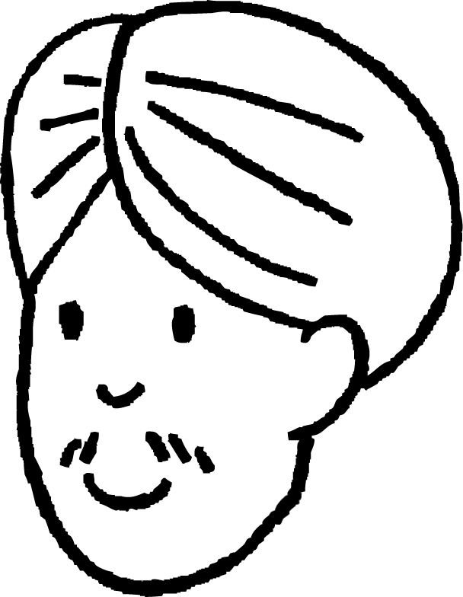

Securing understanding of multiplication
Andeep and Sofia are calculating 24 × 15.
They both decide to partition the 24 and 15.
24 × 15
24 × 15
2 × 12
×
3 × 5
4 × 6
×
3 × 5
2 × 3
×
12 × 5
×
6 × 3
4 × 5
6
×
60
= 360
×
18
20
= 360

Slide 8
Securing understanding of multiplication
Can you think of some other ways to calculate 24 × 15 ?
How about multiplications with more digits?
e.g. 573 × 429

Slide 9
Securing understanding of multiplication
We can represent the multiplication
using an area model.
3
2 × 3
The area is 6, so
2
2 × 3 = 6

Slide 10
Securing understanding of multiplication
We can represent any multiplication as an area model.
e.g. 25 × 13
10

Slide 11
Securing understanding of multiplication
25
Let’s add some grid lines to help.
25 × 13
13

Slide 12
Securing understanding of multiplication
10
100
1

Slide 13
Securing understanding of multiplication
25 × 13 =
200
50
200
+ 50
+ 30
+ 30
+ 15
325
30
30
15

Slide 14
Securing understanding of multiplication
The grid method for multiplication which you may be familiar with is actually just a version of the area model.
25
20
5
200
50
10
13
200
+ 50
+ 60
+ 15
13 × 25
3
60
15
325

Slide 15
Securing understanding of multiplication
It is not always possible to draw the area model to scale but it does not matter as it is just a representation of
34 × 218
200
10
8
6000
+ 300
+ 240
+ 800
+ 40
+ 32
6000
300
240
30
4
800
40
32
7412

Slide 16
Securing understanding of multiplication
Often grids are not drawn showing scale at all.
245 × 324
200
40
5
60000
12000
1500
4000
800
100
800
160
20
300
60 000
12 000
1500
20
4000
800
100
+
4
800
160
20
79380

Slide 17
Securing understanding of multiplication
37 × 86
52 × 39
30
7
50
2
80
2400
560
30
1500
60
6
180
42
9
450
18
2400
560
180
42
1500
60
450
18
+
+
3182
2028

Slide 18
Securing understanding of multiplication
Use the area model to answer the following.
Find the answer in the grid and then rearrange the letters to reveal a word.
A | B | C | D | E | F | G | H | I | J | K | L | M
4922 | 5487 | 3286 | 2968 | 8750 | 4899 | 3762 | 7593 | 1508 | 1265 | 3890 | 2206 | 6891
N | O | P | Q | R | S | T | U | V | W | X | Y | Z
4482 | 8975 | 1312 | 1102 | 9310 | 4628 | 2146 | 1006 | 5465 | 6870 | 7736 | 2547 | 5007
29 × 52
37 × 58
82 × 16
214 × 23
116 × 13
6) 245 × 38
7) 74 × 29
8) 83 × 54
9) 359 × 25

Slide 19
Securing understanding of multiplication
Use the area model to answer the following.
Find the answer in the grid and then rearrange the letters to reveal a word.
A | B | C | D | E | F | G | H | I | J | K | L | M
4922 | 5487 | 3286 | 2968 | 8750 | 4899 | 3762 | 7593 | 1508 | 1265 | 3890 | 2206 | 6891
N | O | P | Q | R | S | T | U | V | W | X | Y | Z
4482 | 8975 | 1312 | 1102 | 9310 | 4628 | 2146 | 1006 | 5465 | 6870 | 7736 | 2547 | 5007
29 × 52 = 1508 I
37 × 58 = 2146 T
82 × 16 = 1312 P
214 × 23 = 4922 A
116 × 13 = 1508 I
6) 245 × 38 = 9310 R
7) 74 × 29 = 2146 T
8) 83 × 54 = 4482 N
9) 359 × 25 = 8975 O
The word is partition

Slide 20
Checking and securing understanding of multiplication and division
Securing understanding of multiplication
Securing understanding of division

Slide 21
Securing understanding of division
Lucas knows that multiplication and division are inverses of each other.
He wonders if he could use the area model to divide.
What do you think?
Let’s take a look at 90 ÷ 6
= 15
15
?
10
5
90
90
6
60
30

Slide 22
Securing understanding of division
Lucas has now decided that partitioning numbers could be a useful way to divide.
Here are some ways of partitioning 98.
Can you think of any more?
90 + 8
95 + 3
Which method of partitioning is the most useful for calculating
98 ÷ 7?
98
80 + 18
70 + 28
Lucas has decided that 70 + 28 is the most useful.
Why do you think that is?
50 + 48
Both 70 and 28 are divisible by 7.

Slide 23
Securing understanding of division
98 ÷ 7
= 14
How does this compare to the short division method?
14
?
10
4
1 4
98
98
2
7
7
9 8
70
28
Which do you prefer?

Slide 24
Securing understanding of division
259 ÷ 7
= 37
Let’s compare methods again.
37
?
10
10
10
7
3 7
259
2 4
210
7
2 5 9
7
70
70
70
49
This is only one way to partition 259, could you have done it differently?
Which do you prefer?

Slide 25
Securing understanding of division
259 ÷ 7
= 37
Let’s compare methods again.
37
?
10
10
10
7
3 7
259
2 4
259
7
2 5 9
7
70
70
70
49
210
This is only one way to partition 259, could you have done it differently?
Which do you prefer?

Slide 26
Securing understanding of division
294 ÷ 6
e
10
10
10
10
d
a
6
b
b
b
b
c
Find the value of each letter.
a = 294
b = 60
c = 54
d = 9
e = 49

Slide 27
Securing understanding of division
Which method of partitioning is the most useful for each of these calculations?
98 ÷ 2
90 + 8
95 + 3
98
80 + 18
70 + 28
50 + 48
Any of the partitions with even numbers.

Slide 28
Securing understanding of division
Which method of partitioning is the most useful for each of these calculations?
98 ÷ 4
90 + 8
95 + 3
98
80 + 18
70 + 28
The divisibility test for 4 is the last 2 digits must by a multiple of 4, so…
Maybe none of those partitions.
50 + 48
98 is not divisible by 4, this means the answer would be decimal.
The best partitions would be those with one multiple of 4.

Slide 29
Securing understanding of division
Which method of partitioning is the most useful for each of these calculations?
98 ÷ 5
90 + 8
95 + 3
98
80 + 18
70 + 28
50 + 48
98 is not divisible by 5 as it doesn’t end in a 0 or 5.
The most useful would be those with one number that is a multiple of 5.
This would be all of them.

Slide 30
Securing understanding of division
Which method of partitioning is the most useful for each of these calculations?
98 ÷ 3
90 + 8
95 + 3
98
80 + 18
70 + 28
Any of the partitions containing multiples of 3.
The divisibility test for 3 is the sum of the digits is a multiple of 3.
So the most useful would be …
50 + 48
For all of these there may be a more useful partition not shown.

Slide 31
Securing understanding of division
Partition 52 to answer the following:
52 ÷ 4
52 ÷ 2
52 ÷ 5
2) Use the area model to complete the following:
138 ÷ 3
441 ÷ 7
456 ÷ 6
949 ÷ 13
5552 ÷ 16

Slide 32
Securing understanding of division
3) Sam is doing a calculation involving division and has chosen to partition their dividend into 40 + 16. What might their divisor be?
4) Sofia is doing a calculation involving division and has chosen to partition her dividend into 50 + 6. What might her divisor be?

Slide 33
Securing understanding of division
Partition 52 to answer the following:
52 ÷ 4 e.g. 40 ÷ 4 = 10 & 12 ÷ 4 = 3, 52 ÷ 4 = 13
52 ÷ 2 e.g. 50 ÷ 2 = 25 & 2 ÷ 2 = 1, 52 ÷ 2 = 26
52 ÷ 5 e.g. 30 ÷ 5 = 6 & 22 ÷ 5 = 4.4, 52 ÷ 5 = 10.4
2) Use the area model to complete the following:
138 ÷ 3 = 46
441 ÷ 7 = 63
456 ÷ 6 = 76
949 ÷ 13 = 73
5552 ÷ 16 = 347
E.g. 2) a)
46
20
20
6
120
3
60
60
18

Slide 34
Securing understanding of division
3) Sam is doing a calculation involving division and has chosen to partition their dividend into 40 + 16. What might their divisor be? e.g. 4 or 8
4) Sofia is doing a calculation involving division and has chosen to partition her dividend into 50 + 6. What might her divisor be? e.g. 2, 5 or 10

Slide 35
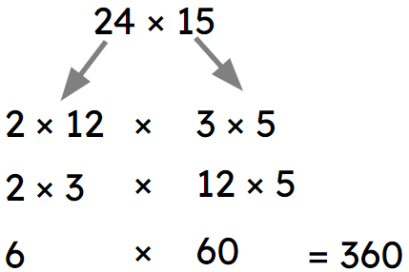
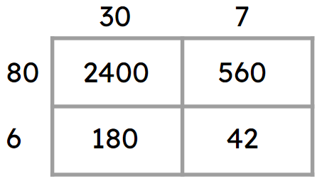
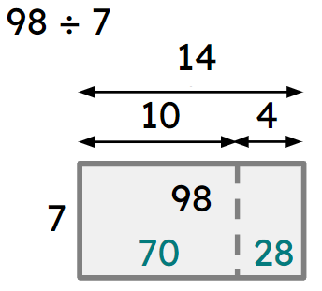
Checking and securing understanding of multiplication and division
Multiplication can be made easier by partitioning.
E.g.
Any multiplication can be represented using the area model. The grid method is an unscaled version of the area model.
E.g.
Division can be made easier by partitioning. E.g.

Slide 36

© Oak National Academy 2023.
Produced in partnership with Mathematics in Education and Industry.
Licensed on the Open Government Licence v3.0, except where otherwise stated. See Oak terms and conditions.

